Slide 1


Introduction to Deep Learning with Keras in R
| Michał Maj | 02/07/2018
Notes:
My goal is to show you the ways how you can excel in public speaking and make your next presentation better.

Slide 2

Scripts and data
https://github.com/maju116/WhyR2018_keras

Slide 3

Who am I
My name is Michał Maj:
- Linkedin https://www.linkedin.com/in/michal-maj116/
- Twitter @MichalMaj116
I am a Data Scientist at Appsilon Data Science (https://appsilondatascience.com)
I am interested in machine learning and statistics. I love new challenges and I'm always ready to help solving data science problems. I'm a big R language enthusiast and a frequent guest in R Enthusiasts meetups in Gdańsk (https://www.meetup.com/Trojmiejska-Grupa-Entuzjastow-R/).
Hobbies: cosmology, string theory, AI, swimming… So basically I’m a nerd who likes to swim :)

Slide 4
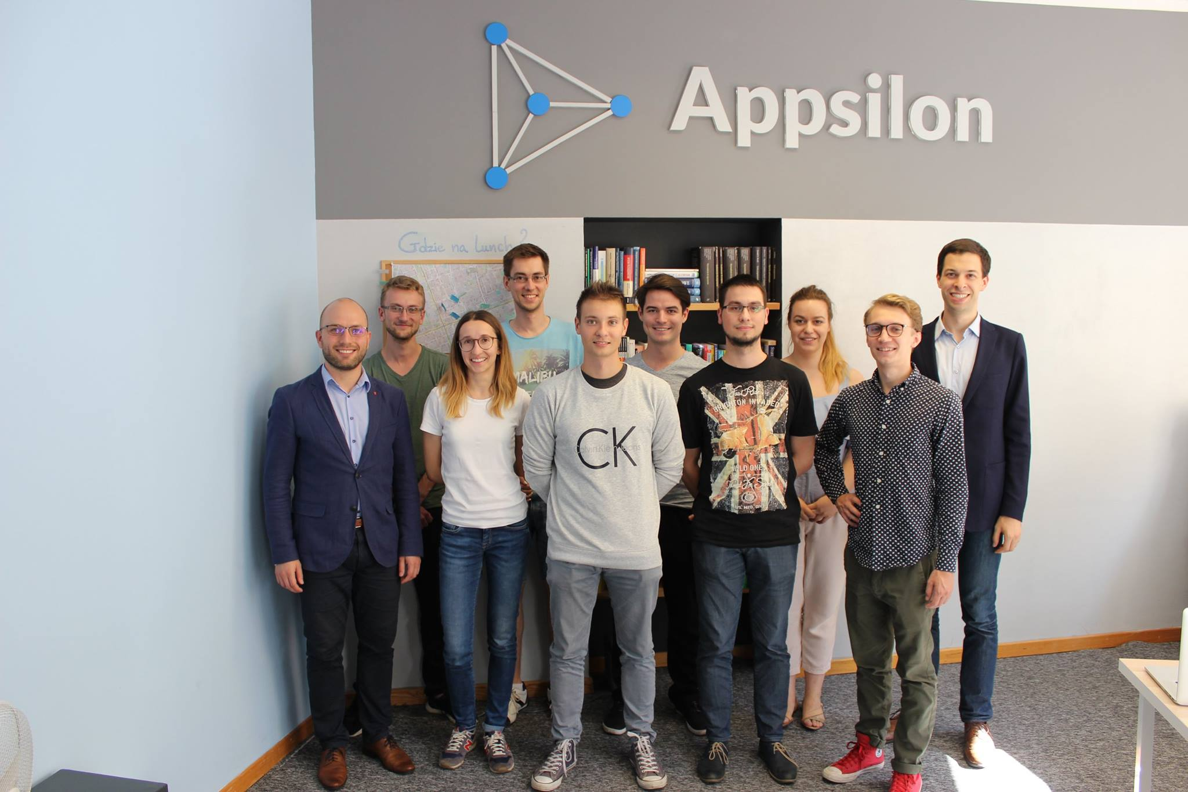
Team

Slide 5
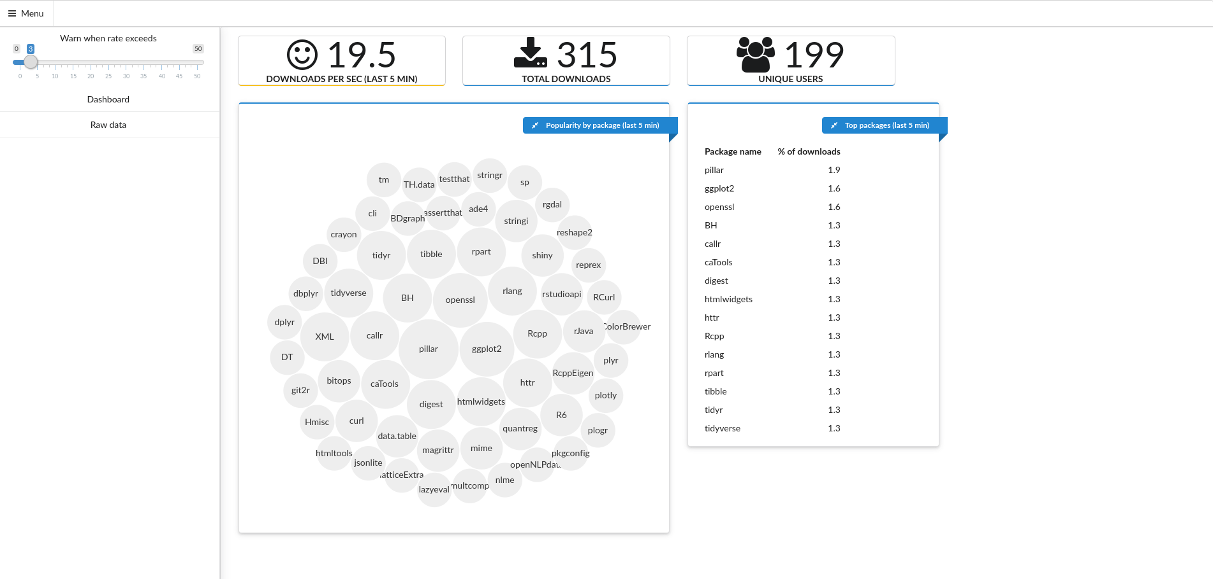
Our open-source

Slide 6
Our work :)

Slide 7
Agenda
Part I:
What is Tensorflow, Keras and other supporting tools in R ?
What are tensors and how they flow ?
Different types of models in Keras ?
What is MLP ?
How to build, compile, fit and evaluate model in Keras ?
What is dropout and how to use it ?
Part II:
What is ConvNet ?
How to represent image as tensor ?
How to build ConvNet in Keras
What is Batch Normalization ?
Part III:
How to insert data directly into Keras ?
What is and how to perform data augmentation using generators ?
What is fine-tuning and how to do it in Keras ?

Slide 8

What is Tensorflow ?
TensorFlow:
is general purpose numerical computing library (not only Deep Learning!).
is an open-source software.
allows you to deploy computation to multiple CPUs, GPUs and TPUs.
was developed by researchers and engineers working on the Google Brain Team.

Slide 9
What “flows” ?
You can think of a tensor as of a multidimensional array:
Data | Tensor
Vector data | 2D tensor: (samples, features)
Timeseries data | 3D tensor: (samples, timestep, features)
Image | 4D tensor: (samples, height, width, channels)
Video | 5D tensor: (samples, frames, height, width, channels)

Slide 10
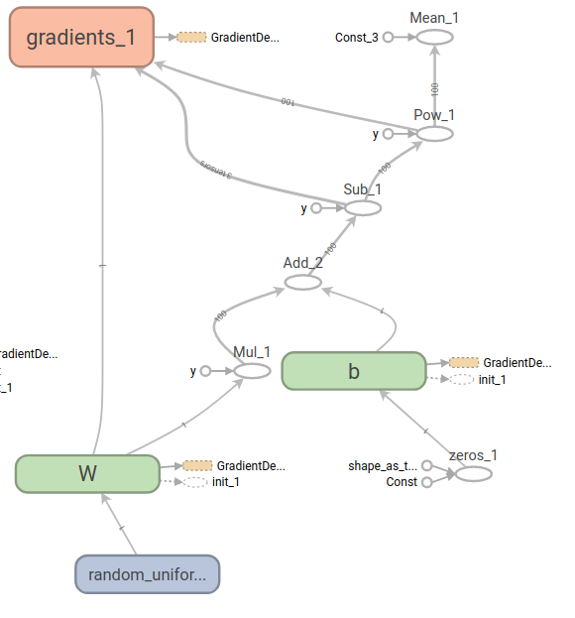
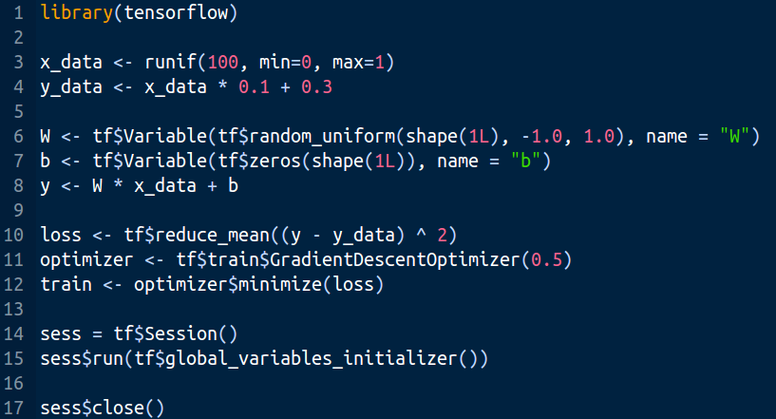
The “flow”
A TensorFlow graph is a description of computations. Tensors flow between nodes. Node takes zero or more Tensors, performs some computation, and produces zero or more Tensors.

Slide 11
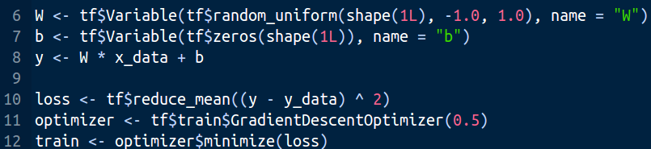
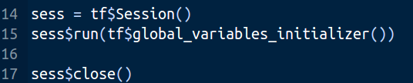
What is happening ?
Create a graph - create constants, variables, operations between them (tensors and nodes)
2. Run the graph in a session

Slide 12

What is Keras ?
Keras:
Keras is a high-level neural networks API capable of running on top of multiple back-ends including: TensorFlow, CNTK, or Theano. One of its biggest advantages is its "user friendliness". With Keras you can easily build advanced models like convolutional or recurrent neural networks.

Slide 13

Keras and Tensorflow in R

Slide 14
Support tools
tfruns—Track, visualize, and manage TensorFlow training runs and experiments. Tune hyperparameters.
tfdeploy—Tools designed to make exporting and serving TensorFlow models straightforward.
cloudml—R interface to Google Cloud Machine Learning Engine.

Slide 15
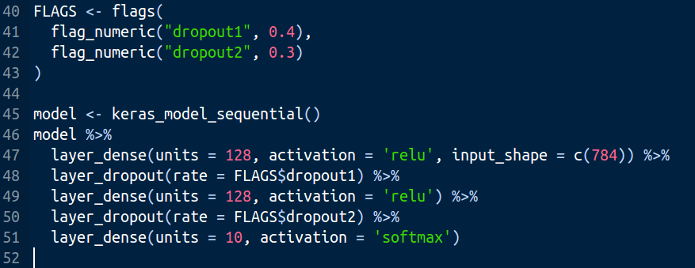
tfruns
Declare flags to control hyperparameters in the model, then use them in model definition. You can use flags for any hyperparameters, not only in model architecture.

Slide 16
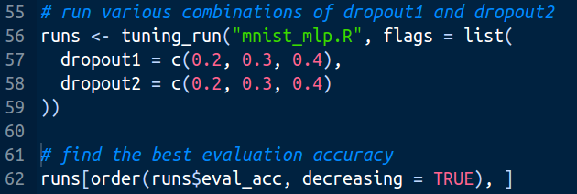
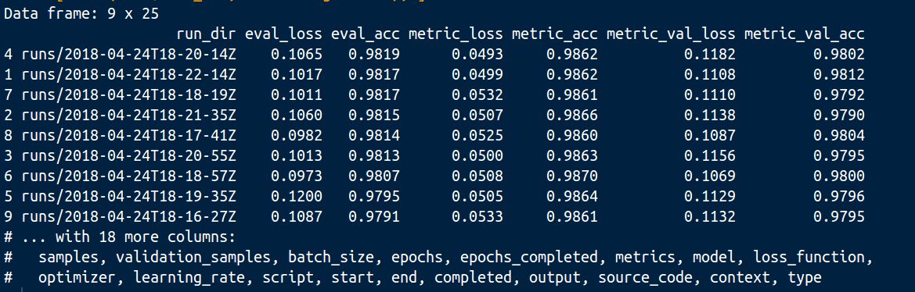
tfruns

Slide 17
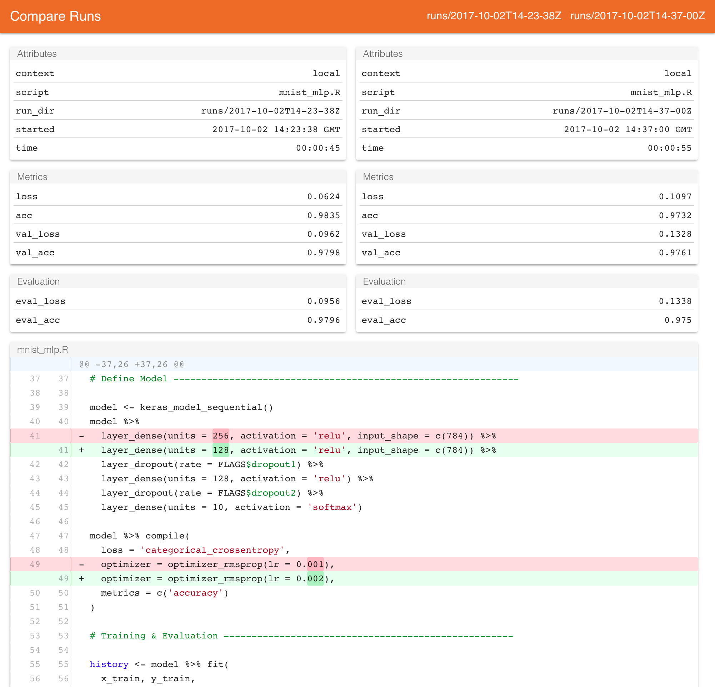
tfruns

Slide 18
Building models in Keras
In Keras you can build models in 3 different ways:
1. Using a sequential model (layer by layer):
MLP, ConvNet, RNN
2. Using functional API (multiple inputs/outputs, shared layers, systems of networks):
Object detection (f.e. Faster R-CNN)
Generative adversarial networks (GANs)
3. Using pre-trained models (applications)

Slide 19
Building models in Keras
Steps to build model in Keras:
1. Define model architecture - choose model type, add layers, define inputs and outputs, add regularization,...
2. Compile - choose loss function, optimizer and metrics
3. Fit - define train/validation sets, callbacks
4. Evaluate / Predict - evaluate on test set

Slide 20
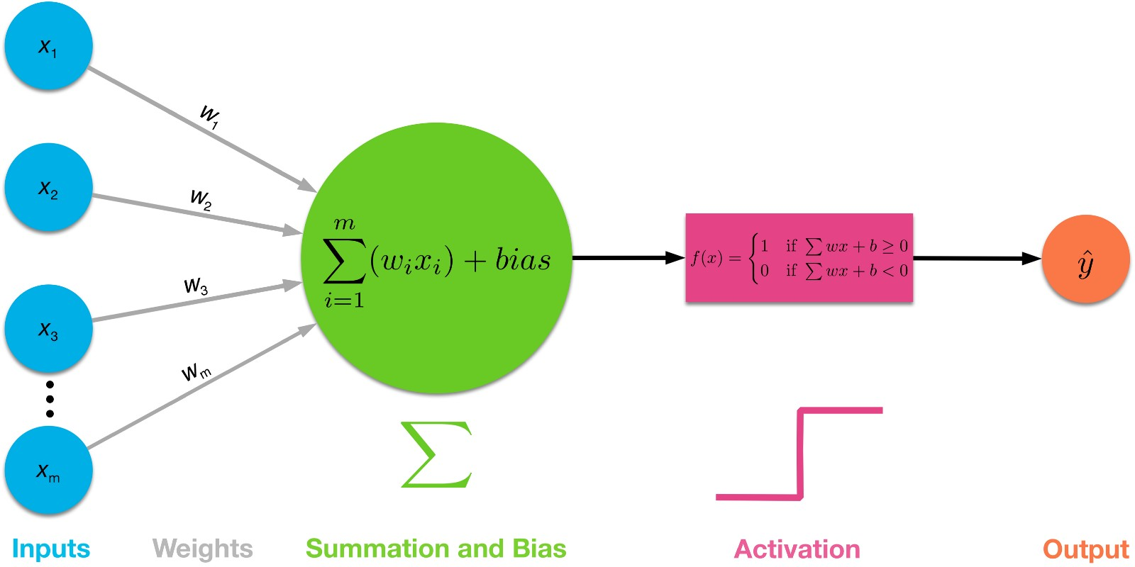
MLP
In a single neuron, output is a linear combination of inputs (and sometimes bias) transformed using (usually) nonlinear activation function.

Slide 21
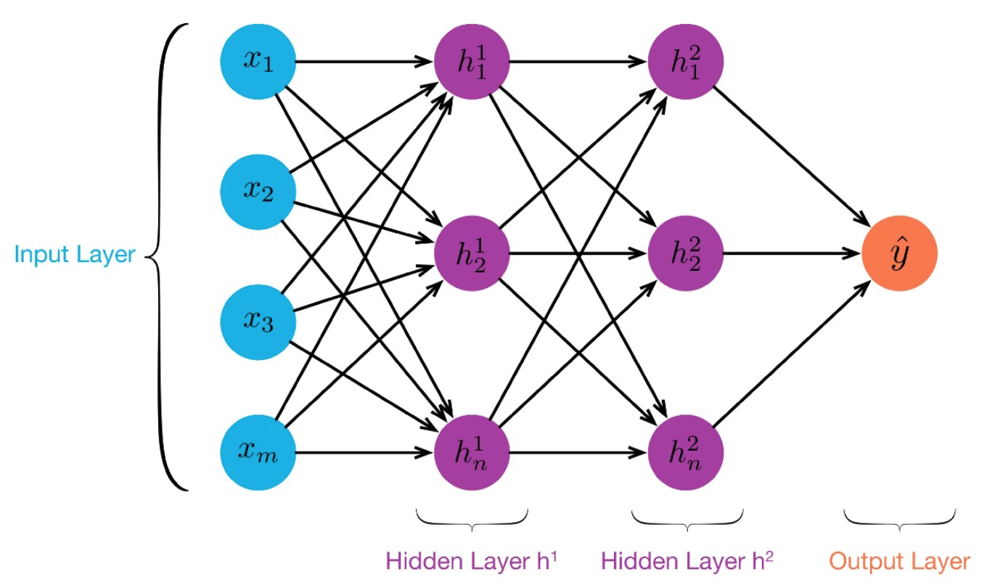
MLP
An MLP consists of at least three layers of neurons (nodes, units). We can think of a neurons in hidden layers as a “new variables” created from initial inputs.

Slide 22
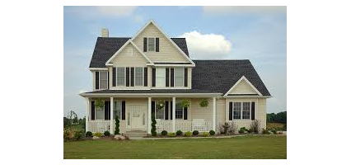
Example
Regression example using Boston housing dataset.
13 inputs and one output (median value of owner-occupied homes in $1000s.)

Slide 23
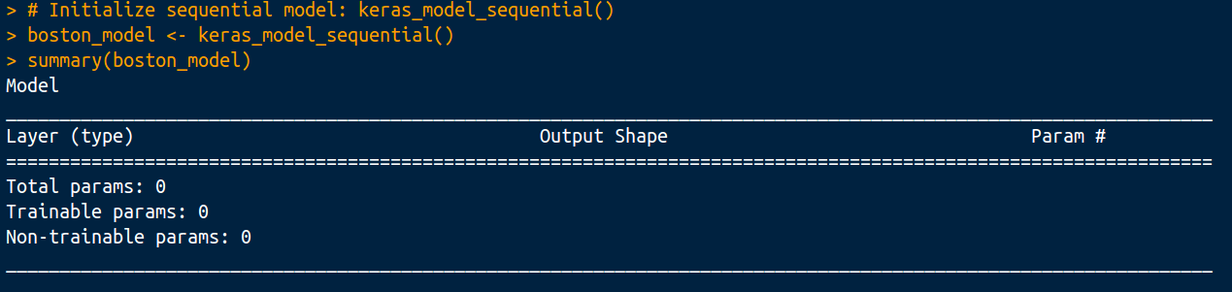
Define model architecture
To initialize a sequential model use keras_model_sequential() function.

Slide 24
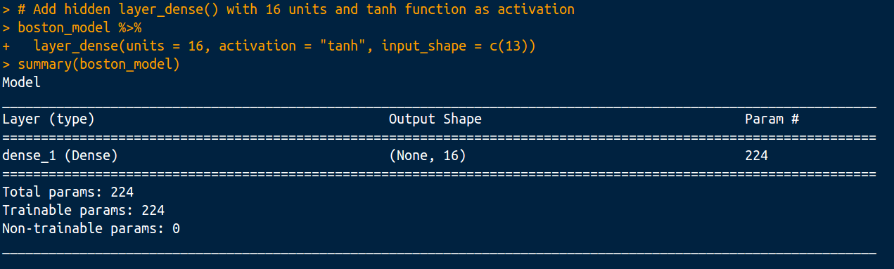
Define model architecture
We can add new layers using %>% operator. Note that keras models are changed in-place and there’s no need for second assignment. layer_dense() adds fully connected layer (here with 16 neurons and tanh as activation). First layer should always specify input shape.

Slide 25
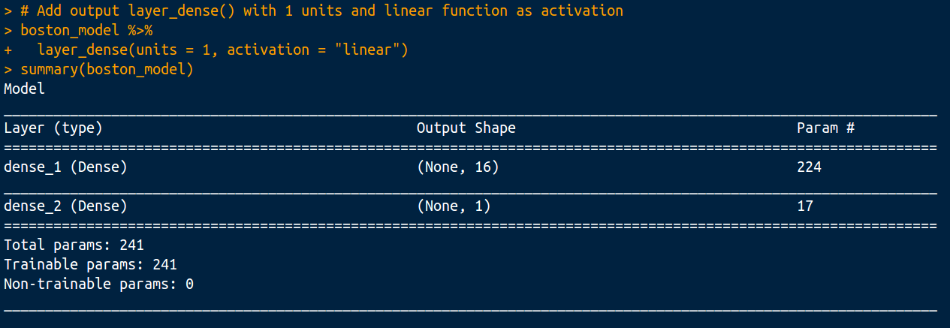
Define model architecture
In similar way we will add output layer. We will use only one neuron with linear activation - regression task.

Slide 26


Loss function and optimization
Neural network weights are updated in a process called backpropagation. Choosing good optimization algorithm is crucial.
Source: http://ruder.io/optimizing-gradient-descent/

Slide 27
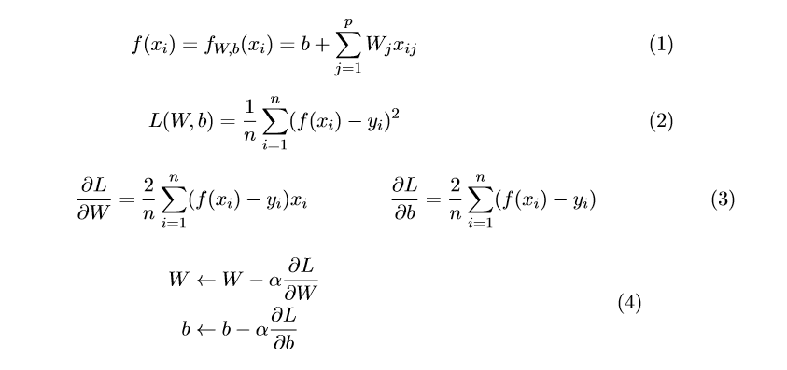
Gradient descent

Slide 28
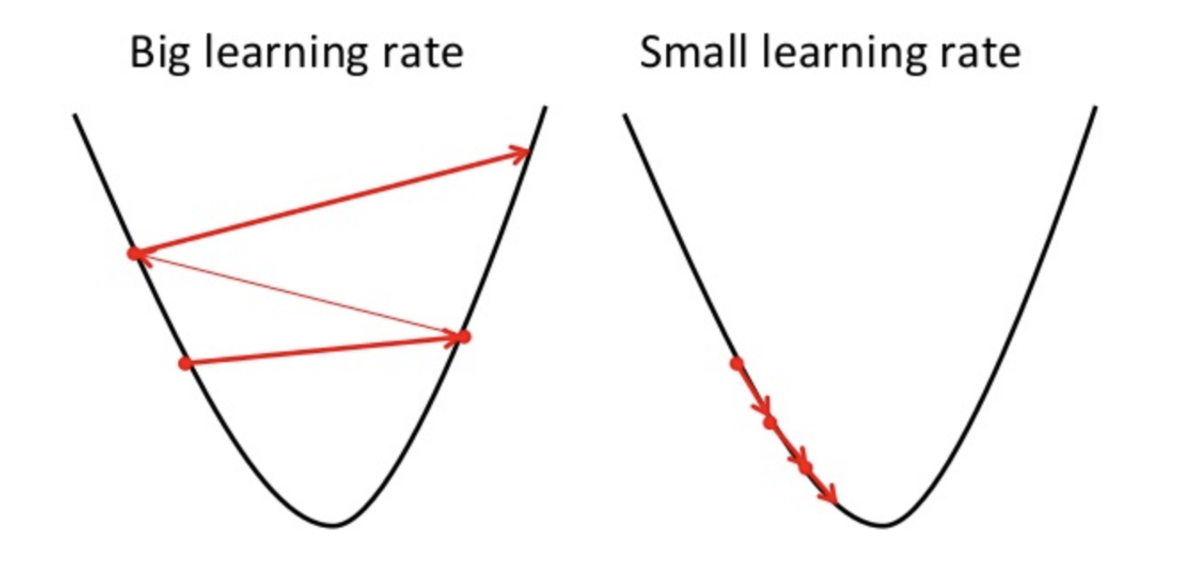
Gradient descent

Slide 29
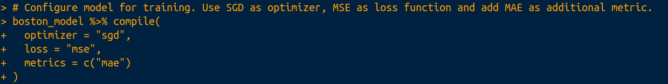
Compile model
After defining architecture of our model we have to configure it for training, we can do this with compile() function. We have to define:
loss - loss function to minimize
optimizer - algorithm that will minimize loss
metrics (optional) - additional metrics to print

Slide 30
Loss functions in keras
Some important loss functions:
Loss | Task
“mse”, “mae” | regression
“binary_crossentropy” | binary classification
“categorical_crossentropy” | multiclass classification
“hinge” | classification
You can always create your own loss function.

Slide 31
Optimizers in Keras
Some important optimizers:
Loss | Function
“sgd” | optimizer_sgd()
“rmsprop” | optimizer_rmsprop()
“adam” | optimizer_adam()
“adadelta” | optimizer_adadelta()

Slide 32
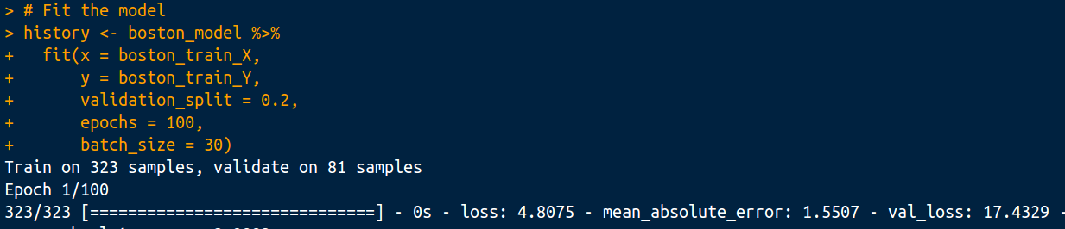
Fitting the model in Keras
To fit the model we can use fit() function. Computing derivatives on a whole dataset can take time. We can divide the dataset into batches and update weights looking only at one batch. Batch size defines number of samples that going to be propagated through the network. Number of epochs defines how many times we should propagate through all dataset. F.e. if I’ve got 9000 samples in train set and I want to create 3 batches, each batch will have 3000 samples. 1 epoch = 3 batches.

Slide 33

Ex. 1 - Fashion MNIST
Each example is a 28x28 grayscale (values from 0 to 255) image (784 variables), associated with a label from 10 classes:
T-shirt/top, Trouser ,Pullover
Dress, Coat, Sandal, Shirt
Sneaker, Bag, Ankle boot

Slide 34
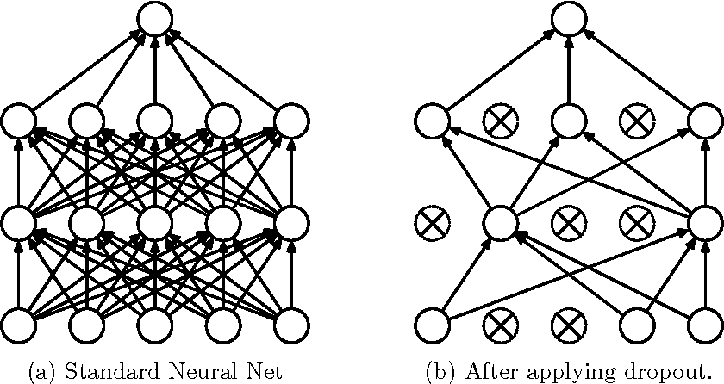
Dropout
At each training stage, individual nodes are either dropped out of the net with probability 1-p or kept with probability p, so that a reduced network is left.

Slide 35
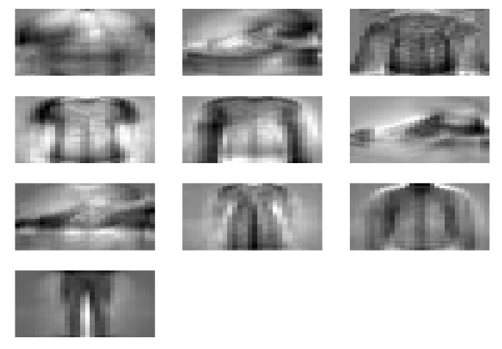
Image classification using MLP
In our example, “new variables” (neurons in first hidden layer) are dependent on every pixel in an image (every pixel will be associated with a weight), so we’re looking at global patterns in our data.
Can we create “new variables” in a better way? How can we search for local patterns?

Slide 36

What is ConvNet ?
Convolutional neural networks (CNN) or ConvNets for short are a class of deep, feed-forward artificial neural networks designed for solving problems like image/video/audio recognition, object detection etc. Architecture of ConvNets differs depending on the issue, but there are some basic common parts.

Slide 37
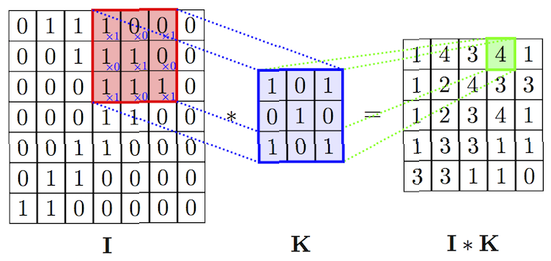
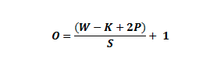
Convolutional layer
The first type of layers in CNN is a convolutional layer and it is a core building block of a ConvNets. Simply speaking in convolutional layers we take a set of small filters (also called kernels) and we're placing them on a part of our original image to get the dot product between kernel and corresponding image part. Next we are moving our filter to the next place and we're repeating this action. Numbers of pixels to move filter are called strides. After getting dot products for whole image we get so called activation map.

Slide 38
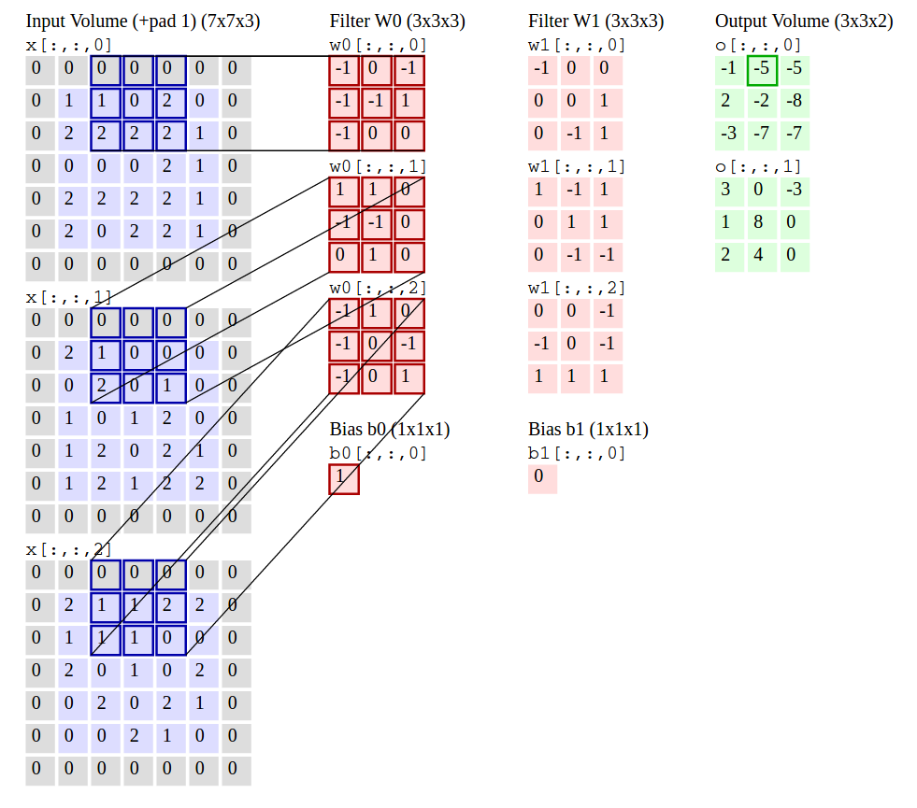
Convolutional layer

Slide 39

Pooling layer
The second type of layers in CNN is pooling layer. This layer is responsible for dimensionality reduction of activation maps. There are several types of pooling, but max pooling is the most common one. As it was in the case of convolutional layers we have some filter (pool) and strides. After placing the filter on an image part we are taking maximum value from that part and then moving to next place by number of pixels specified by strides.

Slide 40
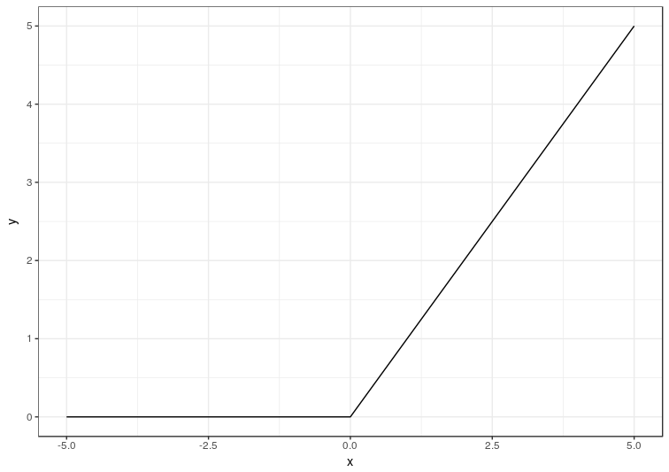
ReLU - rectified linear unit

Slide 41
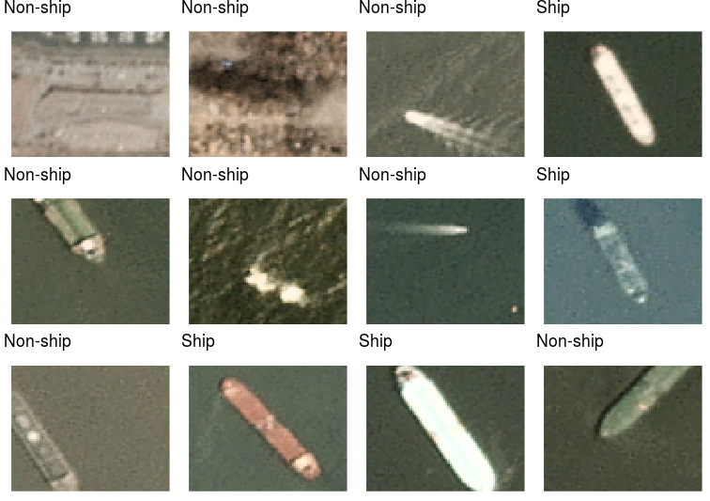
Ex. 2 - Ships classification
We will use a dataset of 2800 satellite pictures (80-pixel height, 80-pixel width, 3 colors - RGB color space). To input data into a Keras model, we need to transform it into a 4-dimensional array (index of sample, height, width, colors). Every picture is associated with a label that could be equal 1 for a ship and 0 for non-ship object.

Slide 42

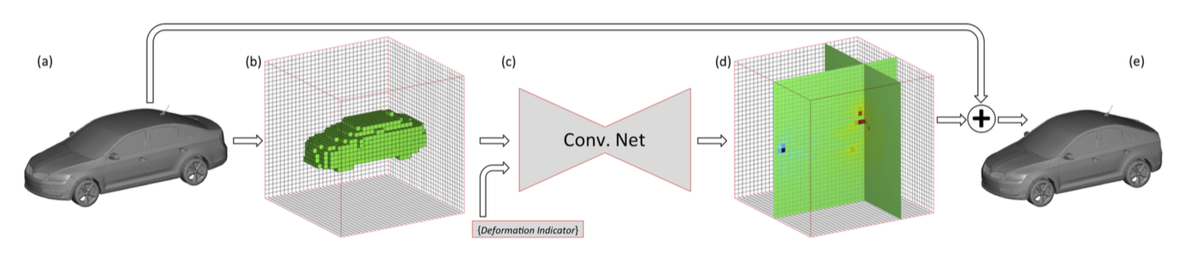
1D and 3D convolution

Slide 43

What’s next ?

Slide 44
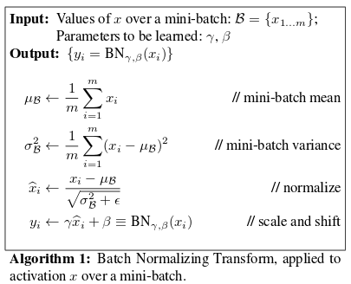
Ex. 3 - Batch normalization and callbacks
Batch normalization reduces the amount by what the hidden unit values shift around (covariance shift).
Batch normalization adds two trainable parameters to each layer, so the normalized output is multiplied by a “standard deviation” parameter (gamma) and add a “mean” parameter (beta)

Slide 45
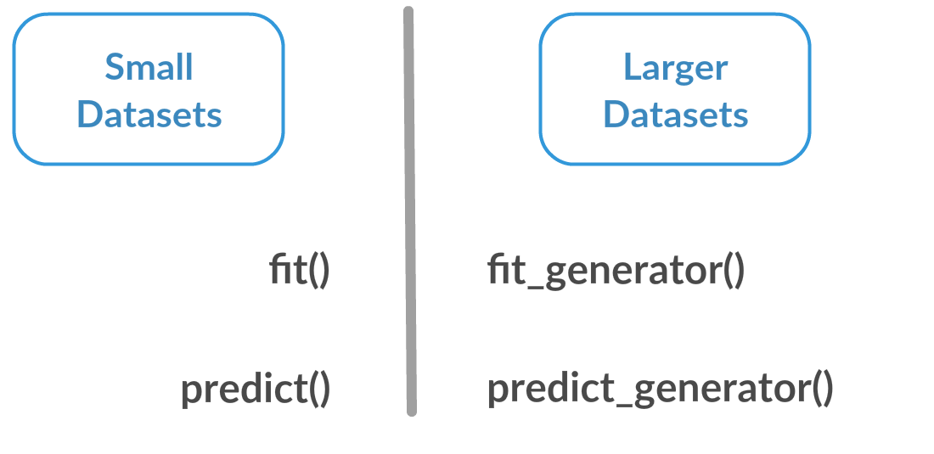
Generators in Keras

Slide 46
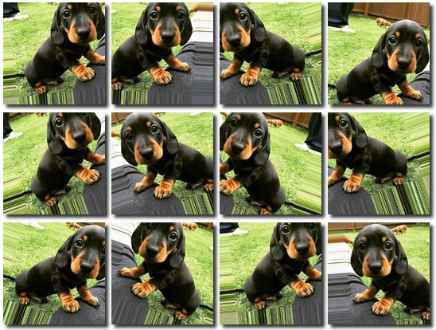
Ex. 4 - Data augmentation

Slide 47
Fine-tuning
Fine-tuning is a process to take a network model that has already been trained for a given task, and make it perform a second similar task.
Steps:
Get pre-trained network using application_NET() function.
Remove dense layers (we want only convolutional base).
Freeze few last layers in convolutional base.
Add randomly initialized dense layers.
Train the model on new data.

Slide 48
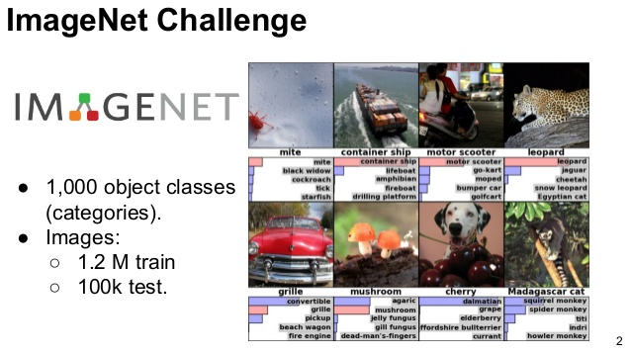
Imagenet

Slide 49
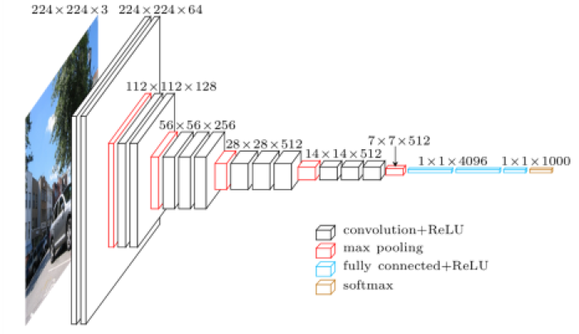
Ex. 5 - Fine-tuning VGG16

Slide 50
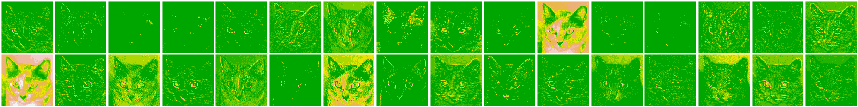
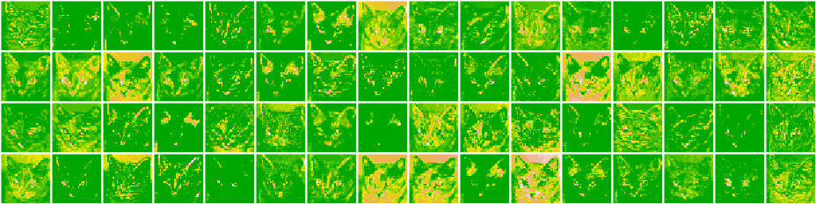
What ConvNet learns ?
Activation map visualization:

Slide 51
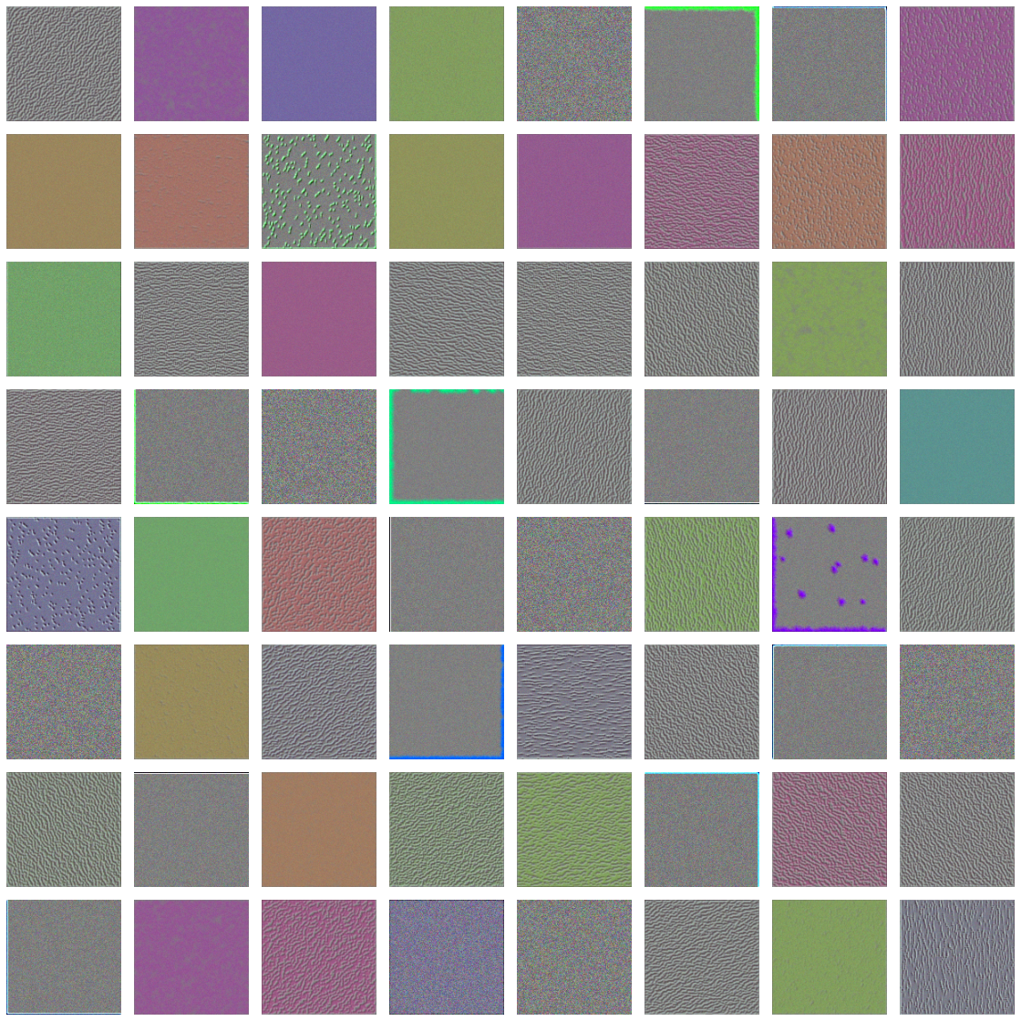
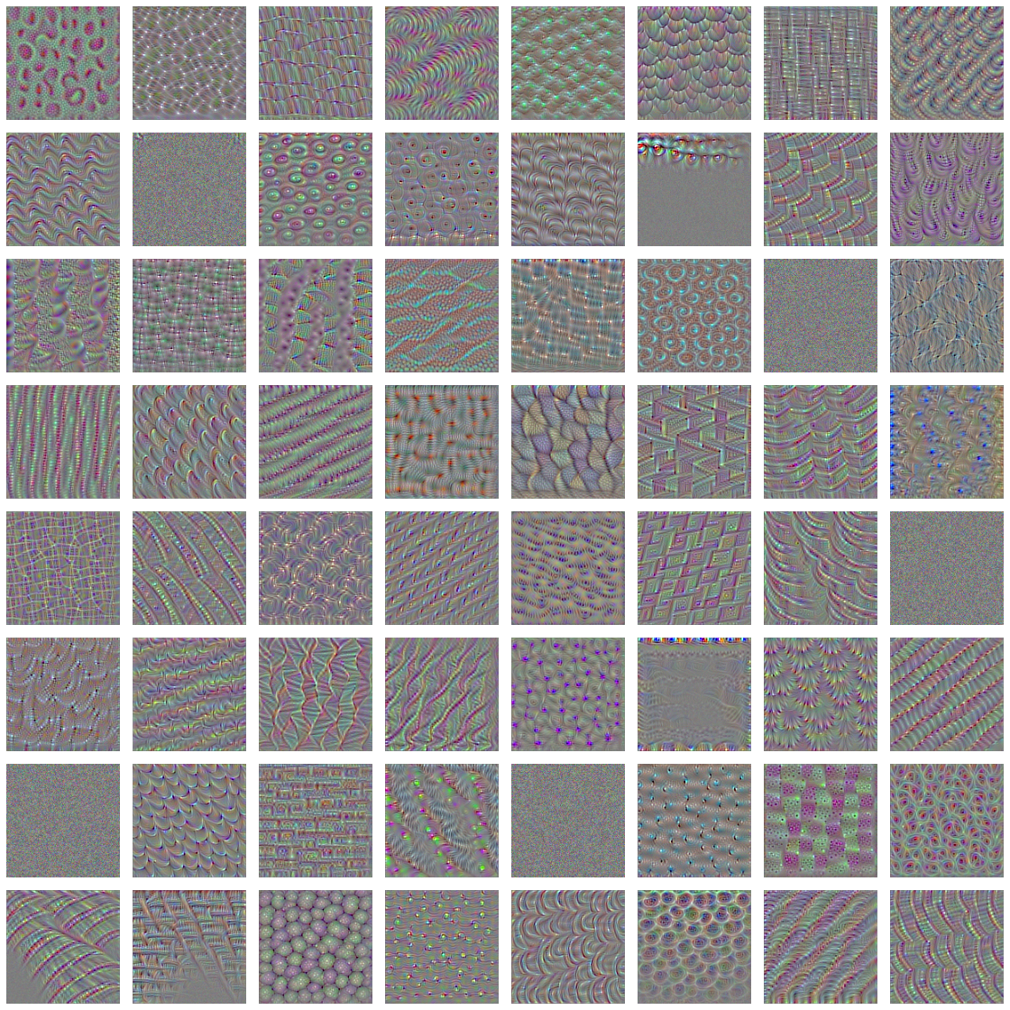
What ConvNet learns ?
Filters (kernels) visualization:

Slide 52

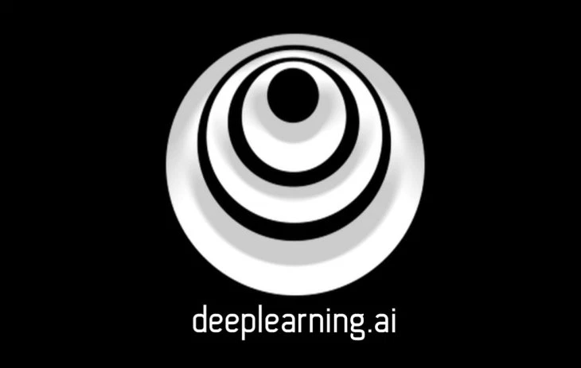
Next steps

Slide 53

Questions?

